Slide 1
Entrepreneurship BS-CS – 2022 – Spring Semester
Salmaan Rahman
Lecture 4
Feasibility Analysis

Slide 2
Feasibility Analysis
Feasibility analysis is the process of determining if a business idea is viable.
It is the second step of a well defined process:
Recognize a business idea
Test the feasibility
Write a business plan
Launch the business

Slide 3
Feasibility Analysis: keep in mind
Many entrepreneurs make the mistake of identifying a business idea and then jumping directly to developing a business model to describe and gain support for the idea.
A feasibility analysis is an assessment of a potential business rather than strictly a product or service idea
Feasibility analysis tests the merits of a specific idea
This provides the opportunity for the idea to be revised, altered, and changed – based on the feedback obtained and the analysis conducted.
Do your secondary research first!

Slide 4
Typical Problems of start-ups
Can be divided into External or Internal
Product/Service
Product/service development (I)
Undistinguished products/service
Inadequate technical knowledge
Sales/Marketing (E)
Low Sales
Dependence on few customers
Marketing and distribution channels, promotion, public relations

Slide 5
Typical Problems
General Management (I)
Lack of management experience
Team in-fighting
Controlling growth
Administrative
Human Resource management (I)
Recruitment/selection
Employee development
Production/operations management (I)
Quality control
Raw materials/resources/supplies
Economic environment (E)
Poor economy

Slide 6
Typical Problems
Obtaining financing (I)
Needed for growth
Internal Financial management (I)
Inadequate working capital
Cash Flow Problems

Slide 7
External Problems

Slide 8
Internal Problems

Slide 9
A feasibility study begins with collecting all the background information we can
Based on this background information we design our feasibility study to get information about our specific business idea

Slide 10
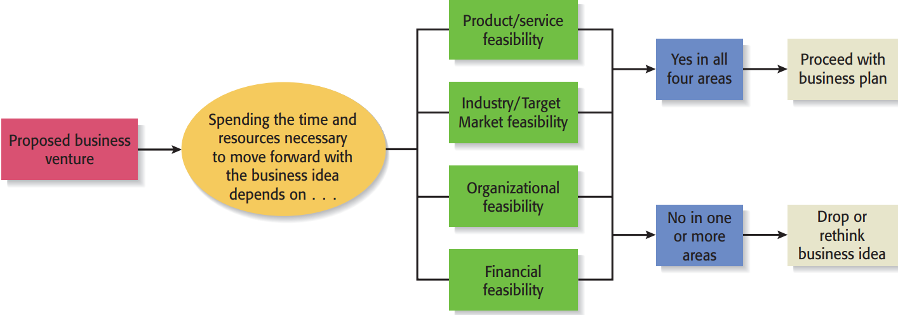
Feasibility Analysis components

Slide 11
Technical Feasibility
Technical specifications
Design, durability, Reliability, Safety, Standardization
Engineering Requirements
Machines, tools, Instruments, Work flow,
Product Development
Blueprints, models, prototypes
Product Testing
Lab testing, field testing
Plant location
Proximity to suppliers, customers, distributors
Environmental regulations

Slide 12
Feasibility Components
(1)
Product/service
Analysis

Slide 13
1) Feasibility: Product/service
Assessment of the overall appeal of the product or service being proposed
Nothing else matters if the product or service itself doesn’t sell.
Two components:
product/service desirability
product/service demand

Slide 14
Feasibility: Product/service Desirability Questions
Does it make sense? Is it reasonable? Is it something real customers will buy?
Does it take advantage of an environmental trend, solve a problem, or fill a gap in the marketplace?
Is this a good time to introduce the product or service to the market?
Are there any fatal flaws in the product or service’s basic design or concept? Is it trademarked? Is it unique enough?
Has a prototype been tested? Weak points? Strengths? How much R&D will it need in the next few years?
Is it easily understood by customers, bankers, capitalists, accountants, lawyers?

Slide 15
Feasibility: Product/service Desirability Testing:
Concept test
a preliminary description of a product or service idea, (aka concept statement)
Usually administered to industry experts and prospective customers to solicit their feedback
Sample size of 20 recommended
Avoid friends/family. Get objective feedback

Slide 16
Feasibility: Product/service Desirability Testing:
Concept Test (cont)
One page document that normally includes:
Description of the product or service. Main features of the product or service; a sketch of it as well
Intended target market - consumers or businesses who are expected to buy the product or service.
Benefits of the product or service. Includes an account of how product or service adds value and/or solves a problem.
A description of how the product or service will be positioned relative to competitors
A brief description of the company’s management team

Slide 17
Feasibility: Product/service Demand Questions
To assess demand, we survey buying intentions
Buying Intentions Survey: an instrument used to gauge customer interest in a product or service and consists of:
A concept statement / description of the product or service
Short survey
Interviews
Questionnaires
Gumshoe research
Internet/library

Slide 18
Feasibility: Product/service Demand Questions
Buying Intentions Survey:
Questionnaires: Questions based on your product/service:
How likely are you to buy the product/service described above?
How much are you willing to pay for it?
Where are you likely to purchase it?
Use Likert scales, ranking methods, or number scales as appropriate
May be conducted in person or on internet

Slide 19
Feasibility: Product/service Demand Questions
Buying Intentions Survey:
Interviews:
Open-ended or close-ended
Gumshoe:
Time/motion studies
Observation
Talking to potential customers directly
Library/Internet:
Secondary research
Primary research – social media interactions, forums, interviews etc.

Slide 20
Feasibility: Product/service Demand Survey
Using Google adWords and landing Pages:
Prepare an ad
buy keywords on Google search page
When someone searches for the keyword a link shows up either at the top or to the right of the search results
If someone clicks on the link, they’ll be taken a landing page that provides direct sales copy (eg: click here to buy a Hawaiian vacation)
Your landing page will show an artist’s depiction of your product or service, provide a brief explanation, and will then say something like “Coming Soon—Please Enter Your E-mail Address for Updates.”
How often your ad appears will depend on what you purchase through Google’s automated AdWord’s keyword auction. Google will provide analytics regarding how many people click on the ad and how many follow through and provide their e-mail address. You can also capture the e-mail addresses that are provided.

Slide 21
Feasibility Components
(2)
Industry and Target Market Analysis

Slide 22
2) Feasibility: Industry and Target Market Analysis
Industry analysis helps you identify:
Your potential (target) market (customers)
Your competitors
Your suppliers
The business environment
An industry is a group of firms producing a similar product or service, such as computers
A target market is the limited portion of the industry that will be interested in your product/service, and which you want to appeal to
Most start-ups select or carve out a specific target market and try to service that group of customers particularly well.

Slide 23
2) Feasibility: Industry and Target Market Analysis
Attractive Industries to enter:
Are young rather than old
Are early rather than late in their life cycle
Are fragmented rather than concentrated
Are growing rather than shrinking
Are selling products or services that customers “must have” rather than “want to have”
Are not crowded
Have high rather than low operating margins
Are not highly dependent on the historically low price of a key raw material, like gasoline or flour, to remain profitable

Slide 24
Feasibility: Industry and Target Market Analysis
Industry attractiveness can be assessed from secondary research
Magazines, professional associations, online databases
Industry reports published by IBISWorld, Mintel, Bizminer, and similar fee-based databases
Typically free if accessed through a university or large public library’s website.
Target Market information:
Internet research
Published information
Multi-industry analysis
Competitor research
Alternative research

Slide 25
Feasibility: Industry and Target Market Analysis
Market potential:
Customers and their dominant characteristics
Age, income, buying habits
Potential market size:
Your Likely share
Potential Sales Volume
Sales Price

Slide 26
Market Questions
What is the overall market?
What are the market segments?
How much penetration is possible?
Any special niches that can be exploited?
Who else is in the market?
How fast is the market growing?
What are the trends?
What is the projected life of the product?
What type of advertizing, marketing plan will it require?

Slide 27
Feasibility Components
(3)
Organizational Feasibility Analysis

Slide 28
Feasibility: Organizational Analysis
Organizational feasibility analysis is done to determine if the proposed business has:
sufficient management expertise
organizational competence
resources
Two primary issues to consider:
Management prowess
Resource (non-financial) sufficiency

Slide 29
Feasibility: Organizational Analysis
Management Constitution - new-venture team
Ownership
Management (employees)
Advisors
Each person is assessed (for future roles) on their
Abilities
Qualifications
Access to professional, social and personal networks

Slide 30
Feasibility: Organizational Analysis
Resource Sufficiency:
Specialized Labor skills
Management
Support staff
Intellectual property issues (e.g patents, trademarks)
Do you own or license?
Affordable office space
Lab space, manufacturing space, or space to launch a service business
Contract manufacturers or service providers
Key equipment needed to operate the business (computers, machinery, delivery vehicles)
Support of local governments and state government if applicable for business launch
Ability to form favorable business partnerships

Slide 31
Feasibility Components
(4)
Financial Feasibility

Slide 32
Financial Feasibility Analysis
Required Financial resources – Capital for
Fixed assets
Current assets
Working capital
Additional Financial resources
Required borrowing
Repayment conditions
Cost of borrowing
Potential sources
Operational cost analysis
Fixed costs
Variable costs
Projected cash flow
Projected profitability

Slide 33
Feasibility: Financial Analysis
Three issues to identify:
Start-up cash
Comparative financial performance
Overall financial attractiveness
A detailed pro forma (projected analysis should be done when writing business plan

Slide 34
Feasibility: - Financial Analysis
Start-up Costs:
Cash needed to prepare the business to make its first sale
Budget should include:
Capital purchases
Operating expenses
Identify reliable sources of capital needed
Self
Investors
Loans – must include plan of how/when to repay
** Start-up cost worksheets are available via SCORE (www.score.org)**

Slide 35
Feasibility: - Financial Analysis
Comparative Performance Information:
Estimating potential financial performance by comparing it to similar, existing businesses
Data often difficult to get – ranges may be estimated
Simple observation and gumshoe research may be only option
Occasionally, owners of non-competitive firms might be willing to share limited amount of information

Slide 36
Feasibility: - Financial Analysis
Overall Financial Attractiveness:
An evaluation of potential sales and projected return – 1-3 years
Financial Attractiveness should be weighed against the following factors:
The amount of capital invested
The risks assumed in launching the business
The existing alternatives for the money being invested
The existing alternatives for the entrepreneur’s time and efforts

Slide 37
Financial Feasibility depends on:
Steady and rapid growth in sales during the first five to seven years in a clearly defined market niche
High percentage of recurring revenue—meaning that once a firm wins a client, the client will provide recurring sources of revenue
Ability to forecast income and expenses with a reasonable degree of certainty
Internally generated funds to finance and sustain growth
Availability of an exit opportunity (such as an acquisition or an initial public offering) for

Slide 38
Feasibility: Tying it together:
Create a “First Screen Worksheet” to bring all information together
Appendix 3.1 in textbook

Slide 39
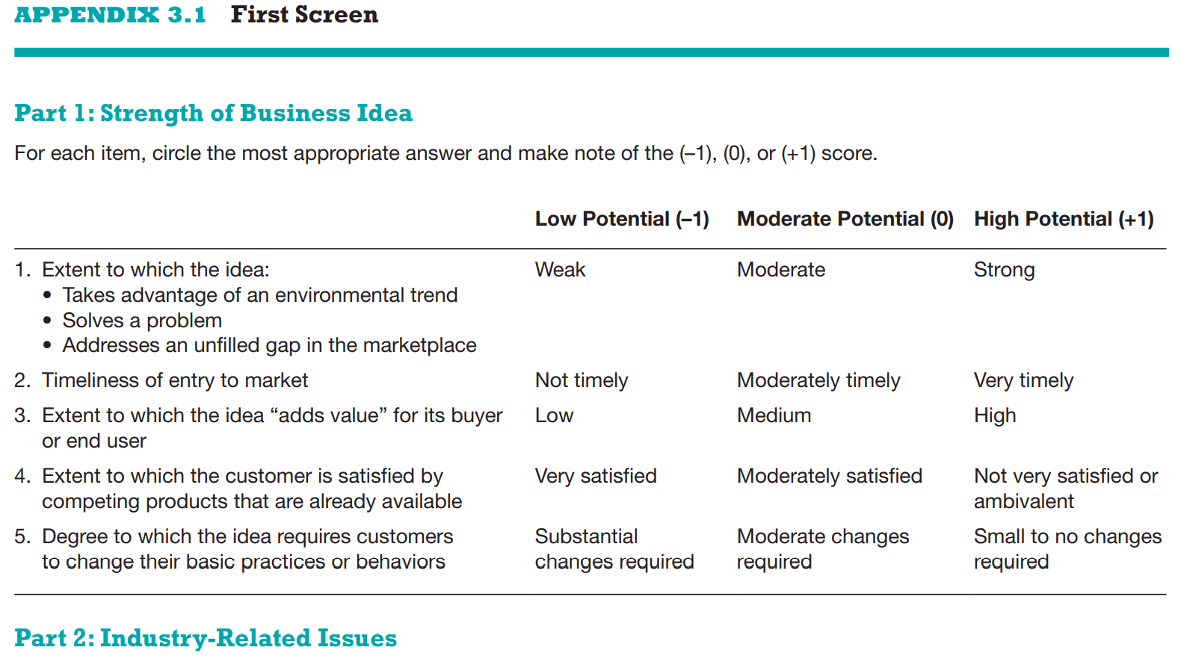

Slide 40
